Slide 1
AFRICA REGION VIRTUAL SBCC CONSULTATION
22 March 2022
Ana Carrapichano

Slide 2
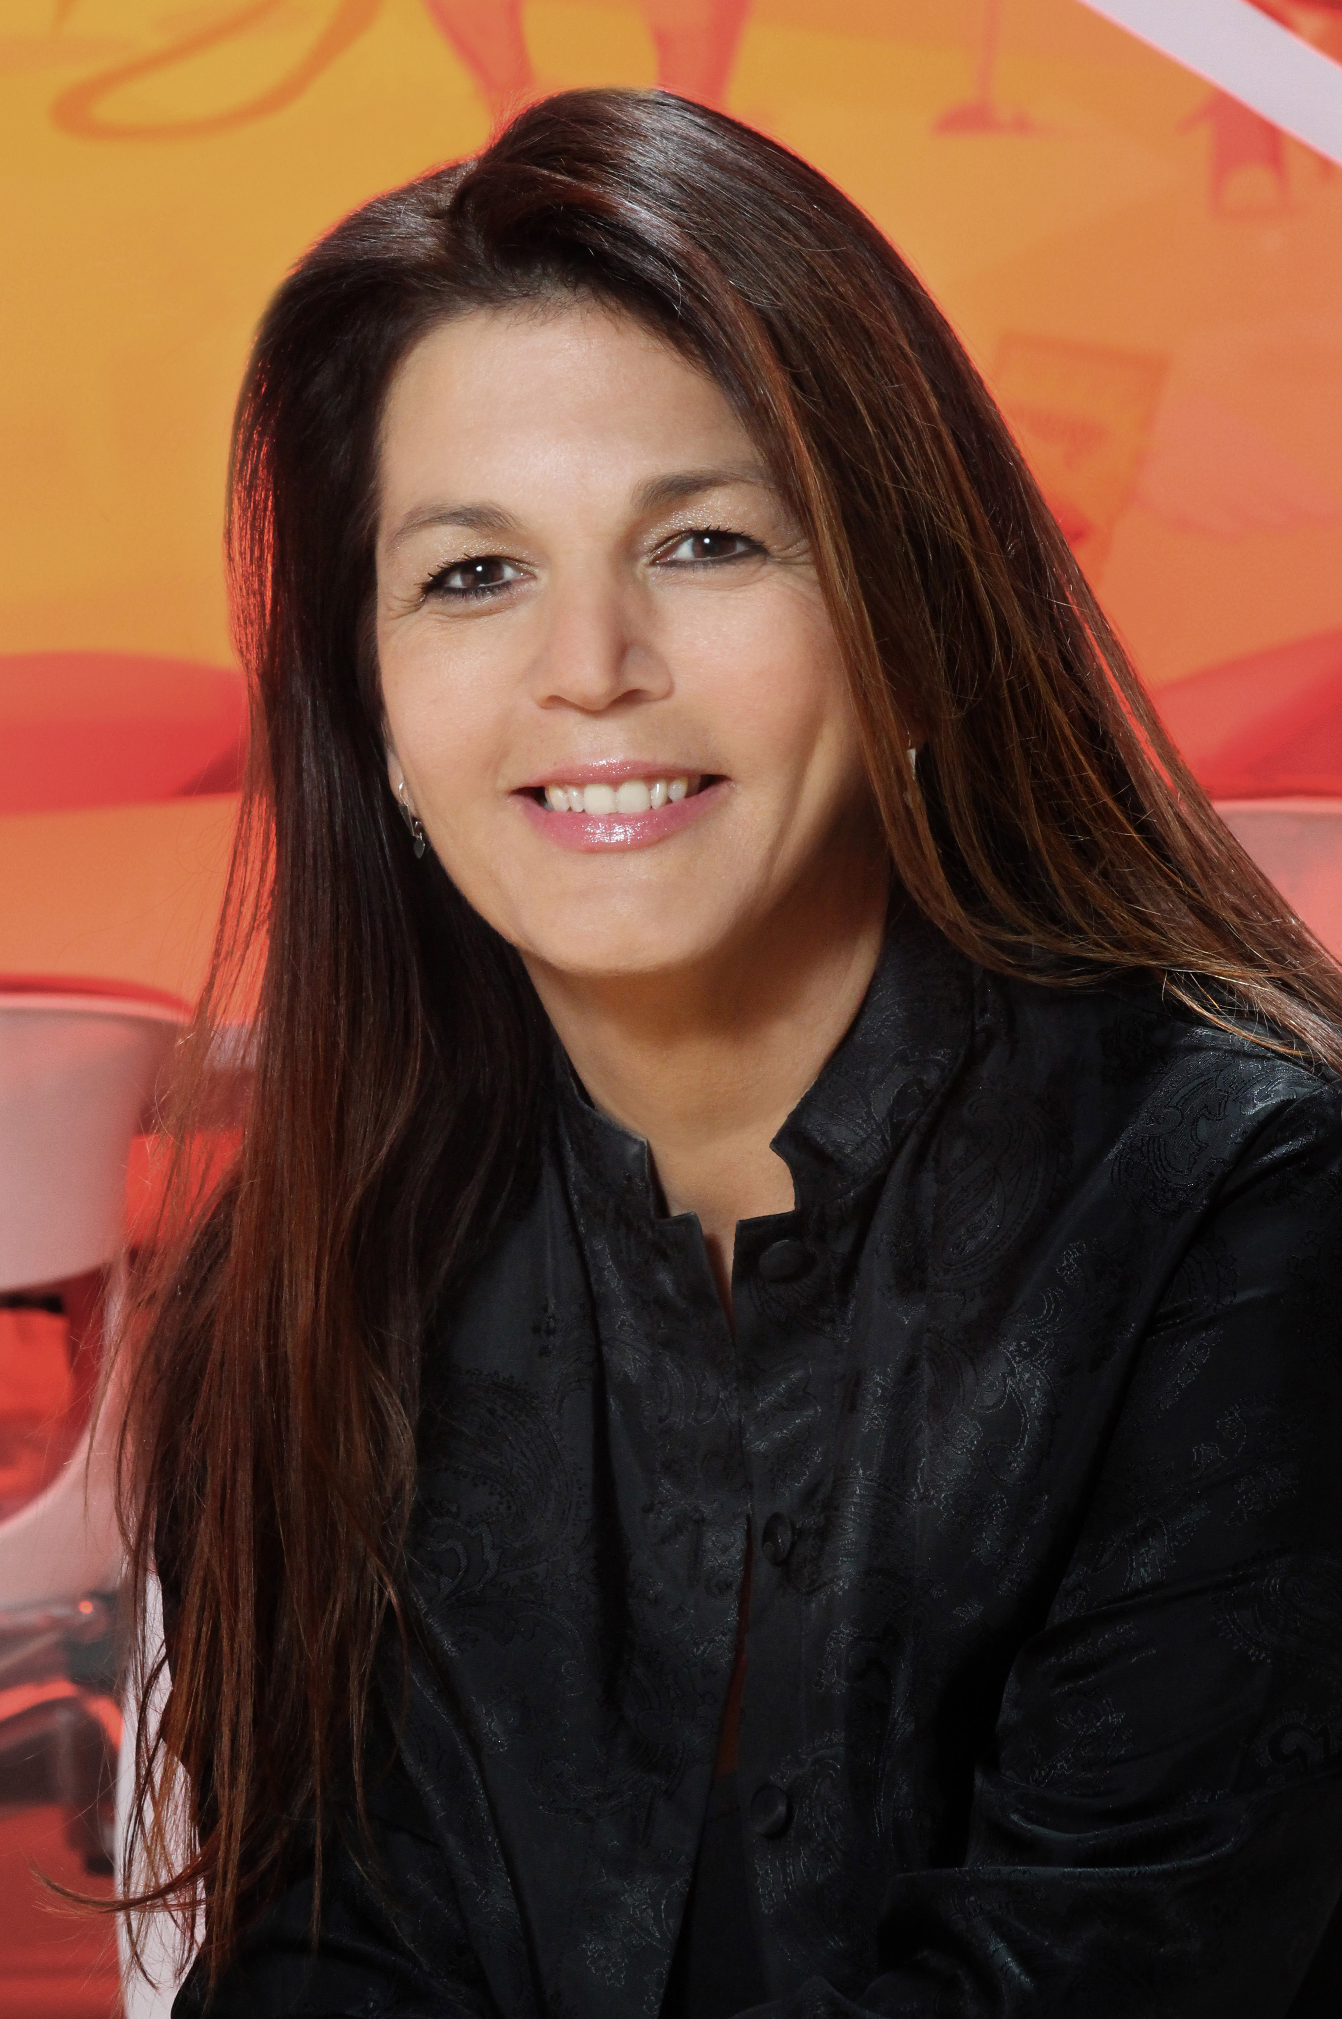
ANA CARRAPICHANO
FOUNDER AND GROUP CEO
MEDIOLOGY
Founder & Group CEO of Mediology, South Africa’s largest media independent
Communications Strategist with 30 years experience in both global and local markets
SBCC communication for the past 14 years – this is where my passion lies – together with my passion for Africa!
International Steering Committee member of the SBCC Summit

Slide 3
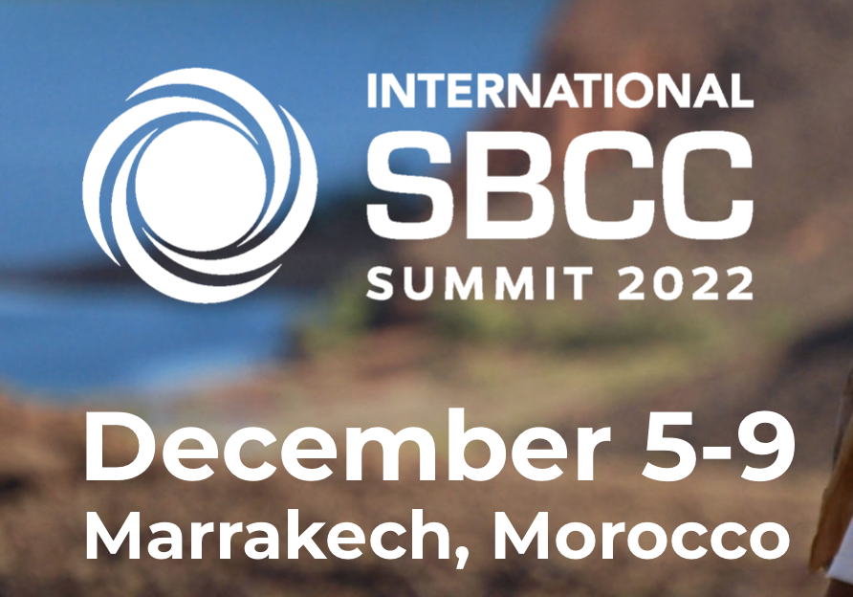
In summary
Thank you to all the presenters and moderators, and you - our audience
Summary of key lessons learnt/take outs of today
Reminder to submit abstracts to the SBCC Summit
Day 2 – SBCC Training on the Continent
www.sbccsummit.org

Slide 4
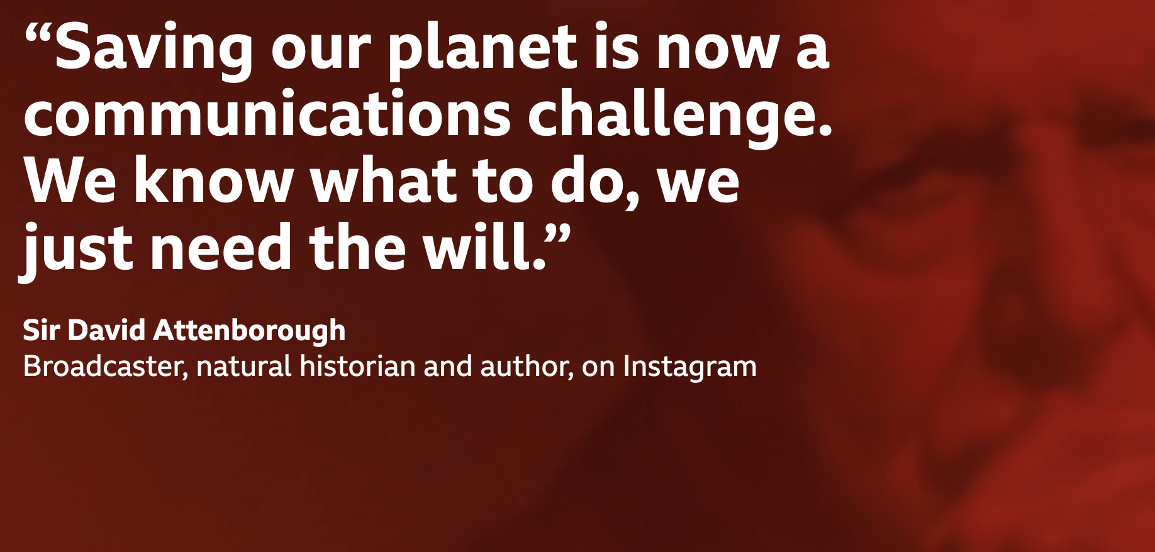


Slide 5
THOUGHTS for building a better future
through communication
Develop an International Communications Strategy addressing Climate Action (Global with Regional Committees)
Raise International Funding
Drive Media Participation and involve Media Specialists to maximise efficiencies
Increase Education and Awareness from mass media to story-telling – encouraging creativity
From Science to Policy
Sharing and Learning Platforms – Exchanging knowledge
From Human Rights to Inspiring Humans to Ignite Behaviour Change
Acknowledging that there isn't one approach - each country/community has different communication requirements
Establish a Global Climate Action Communication Council
Online and offline activism both play a key role in increasing word-of-mouth and viral campaign opportunities (earned media exposure)
Driven at different levels - from National Governments to Private Sector to Local Communities (Encouraging Community Engagement)
Market vulnerabilities such as gender inequalities need to be taken into account
Need to fast track Climate Change Communication - we are behind, especially in Africa

Slide 6
SBCC TRAINING & PRACTICE IN AFRICA:
LESSONS AND FUTURE DIRECTIONS
Day 2

