Slide 1
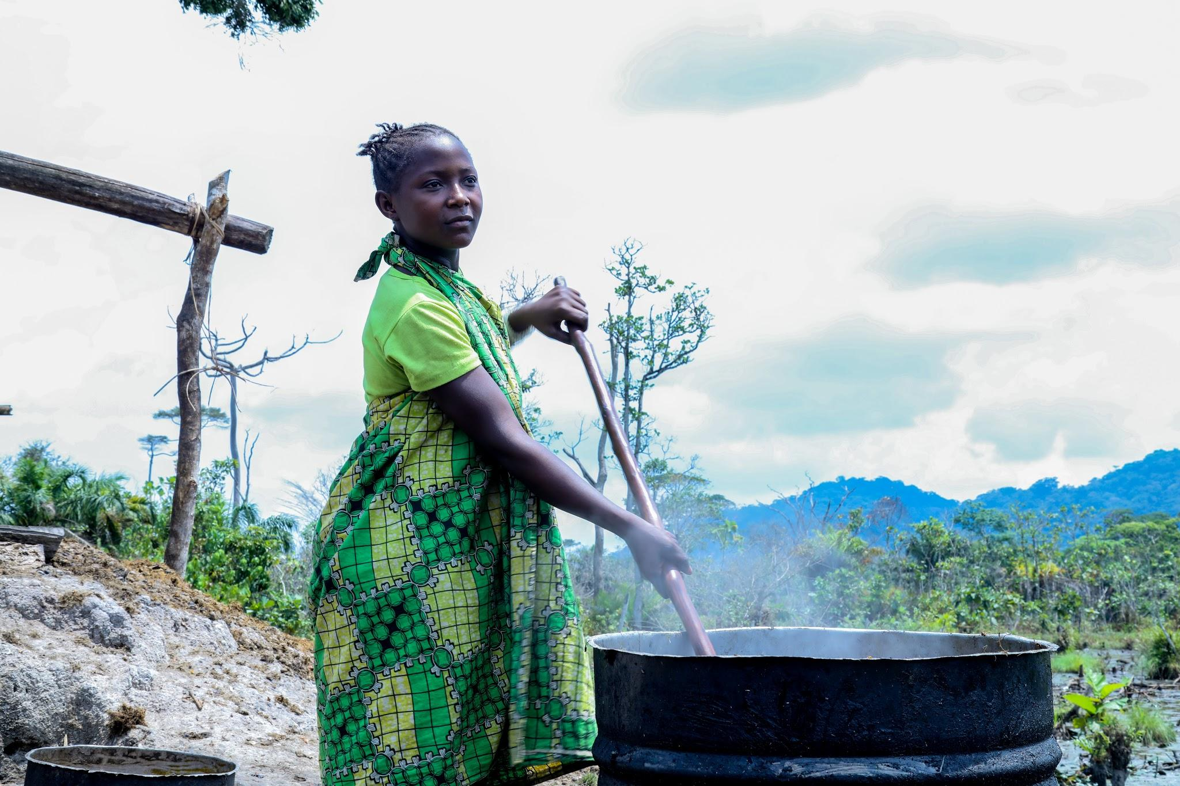

Integrating SRHR into Climate Change Policies

Slide 2
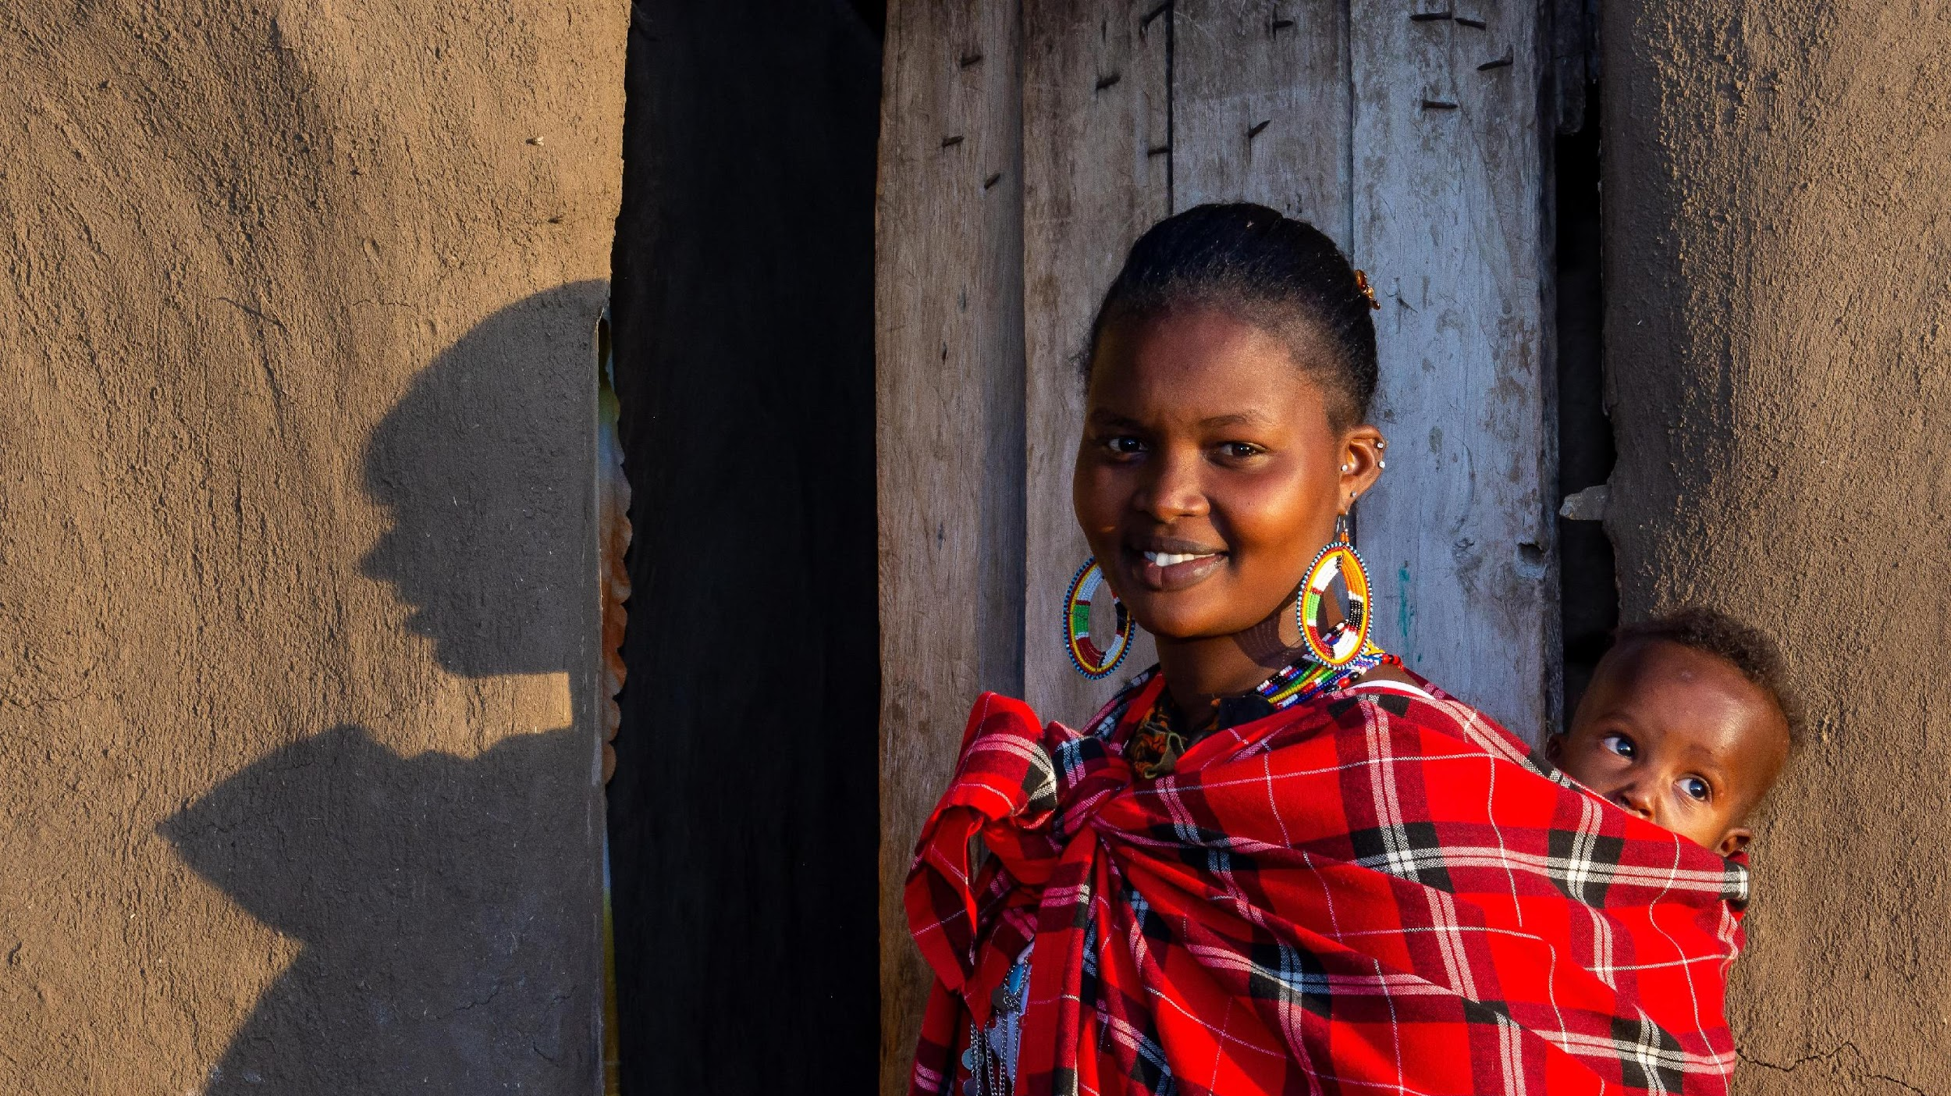

Gender and climate change
Chiagozie Udeh, UNFPA
Policy and Advocacy Analyst on Climate Change for SBCC
22 March 2022

Slide 3
Impact of climate change on gender and SRH/GBV

Slide 4
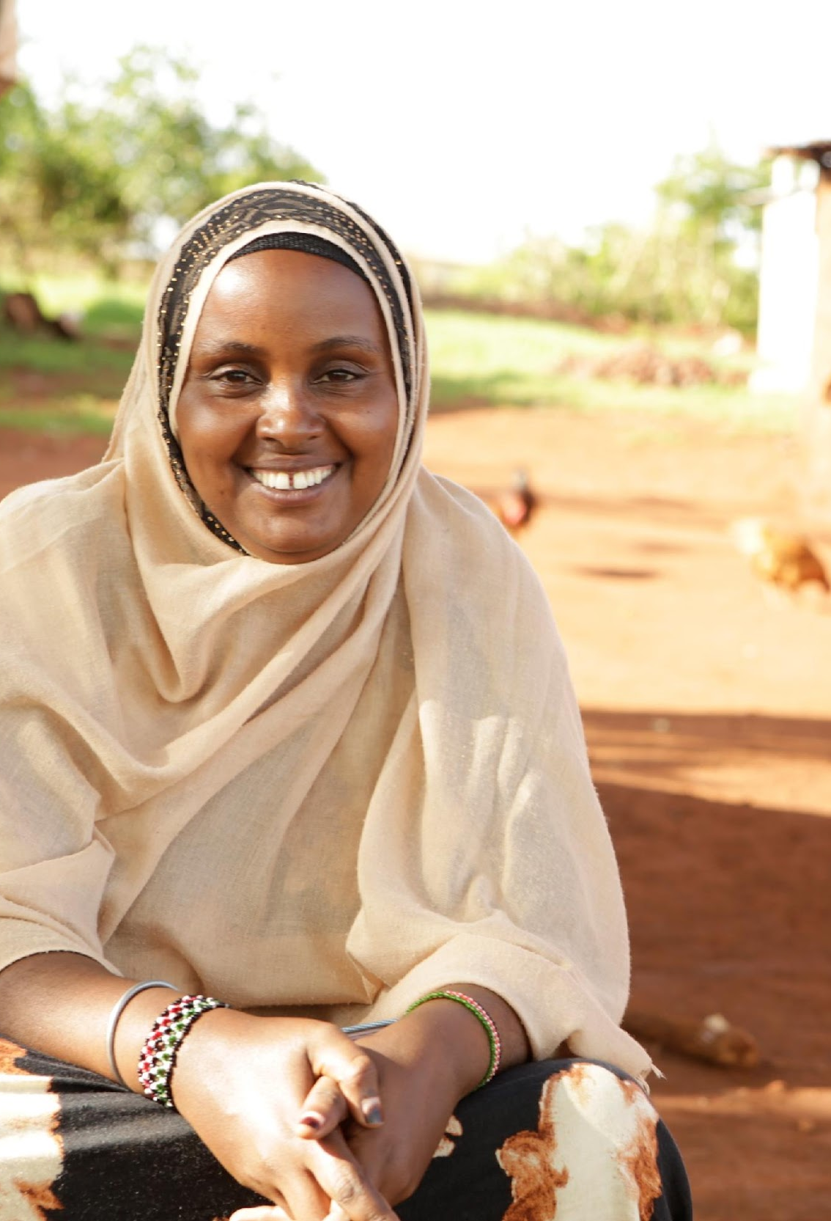
Climate change, adaptation and gender vulnerabilities
Women may have less opportunity to influence household decision-making to mitigate and the decision to migrate
Women have poorer access to resources that could help with adaptation such as land title, irrigation technologies, financial assets and formalized safety nets
Discriminatory, patriarchal laws, norms, customs and institutions exclude women from participating in decision-making and community processes to adapt to climate change
Women’s work is particularly dependent on the reliable availability of water and wood fuel and will have to walk longer distances to fetch firewood when climate change hits. This leads to increase in women’s labor time, physical strain, and risk of GBV
Notes:
Source: https://reliefweb.int/report/world/gender-displacement-and-climate-change-july-2020
https://www.sierraclub.org/gender/women-move-changing-climate
OECD Social Institutions and Gender Index (2014),
https://unfccc.int/sites/default/files/resource/sbi2019_inf8.pdf
https://digitalcommons.law.uw.edu/wjelp/vol4/iss1/6/

Slide 5
Climate change, adaptation and gender vulnerabilities
Only in 37 % of 160 countries, women and men have equal rights to own, use and control land.
In more than half, while the law guarantees women and men the same rights to own, use and control land, customary practices prevent access for women.
Insecure land tenure means that women have fewer resources and capacity to cope with climate change impacts (OECD study)
Other vulnerabilities include limited awareness of legal rights, unequal burden of unpaid domestic and care work; and impoverishment, including when a male spouse migrates or otherwise leaves the household
Notes:
Source: https://reliefweb.int/report/world/gender-displacement-and-climate-change-july-2020
https://www.sierraclub.org/gender/women-move-changing-climate
OECD Social Institutions and Gender Index (2014),
https://unfccc.int/sites/default/files/resource/sbi2019_inf8.pdf
https://digitalcommons.law.uw.edu/wjelp/vol4/iss1/6/

Slide 6
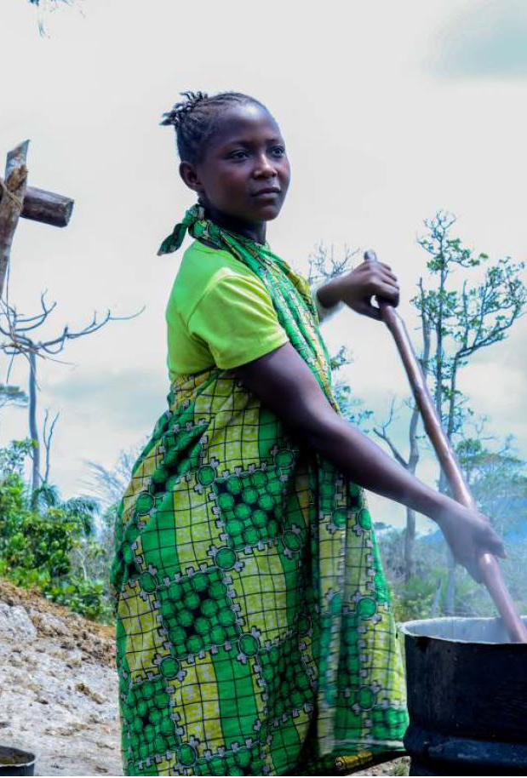
Climate disasters and gender
Women and girls are often disproportionately vulnerable to natural disasters due to underlying gender inequalities as women:
  Are less likely to know how to swim and risk dying during flooding
  Have more insecure forms of employment and more affected by economic disruption
  Are more likely to experience sexual exploitation and trafficking
  Have high burden of unpaid work as they play a key role as first responders in post-disaster situations attending to both the immediate and early recovery needs or families and communities
  May face barriers in accessing information
  Are more likely to experience adverse mental health outcomes when losing social networks/capital and suffer psychosocial impacts of disaster displacement
Notes:
Source:
a) Neumayer, Eric & Plümper, Thomas. (2007). The Gendered Nature of Natural Disasters: The Impact of Catastrophic Events on the Gender Gap in Life Expectancy, 1981-2002. Annals of the Association of American Geographers. 97.

Slide 7
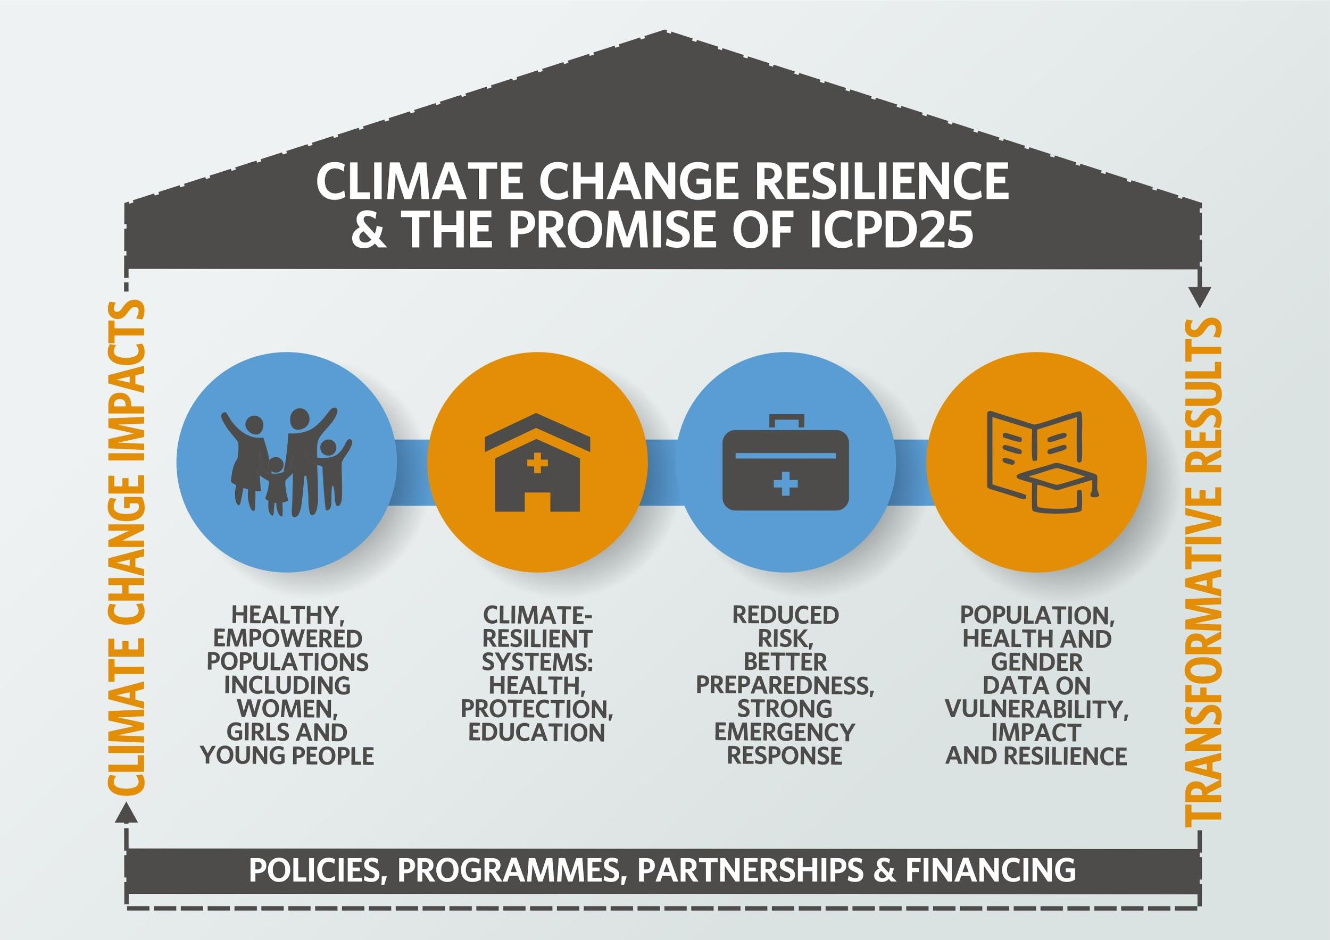
Impact of Climate Change on SRHR
Climate change is a major threat to the vision of human-centred sustainable development as outlined by ICPD PoA
Climate change is a multiplier of existing health vulnerabilities and gender inequalities and will make the transformative results more difficult to achieve and sustain over the Decade of Action.
Notes:
I just would like to take few minutes to reflect on the UNFPA value proposition on climate change that was launched in December and highlight key points and proposed action for how we see the integration of CC in our programming.

Slide 8
Climate change impact on Maternal Health
Recent Lancet article (Feb, 2021) - Call to Action direct/indirect impact
Direct impact:
Heat worsens maternal and neonatal health outcomes, an increase of one degree Celsius in the week before delivery corresponds with a six per cent greater likelihood of stillbirth (Ha et al., 2017)
Global heating impacts the patterns of vector-borne diseases, such as malaria, with negative outcomes such as maternal illness and low birth weight (WHO, 017).
Climate change worsens global inequity in maternal nutrition (Lancet 2020)
Indirect impact:
Climate-related emergencies cause major disruptions in access to health services and life-saving commodities, including contraception (Behrman & Weitzman, 2016).
Increased poverty and food insecurity driven by climate-related loss of livelihoods and affect maternal health etc (Lancet 2021)
Notes:
Lancet call to Action : “Climate adaptation plans need to consider vulnerable populations such as pregnant women and neonates and a broad multisectoral approach to improve overall resilience of societies”.

Slide 9
Impact of Climate change on FP
Climate-related emergencies cause major disruptions in access to life saving commodities including contraception (various evidences)
When the climate crisis is combined with the related nature and pollution crises, there are further impacts of SRHR (UNEP, 2020)
Climate-related events may also enable situations where people are at greater risk of contracting HIV (Low et al., 2019)
Reduced access to SRHR for LGBT rights in emergencies (Gillard, 2017).

Slide 10
Impact of CC on GBV
Climate Change increases the risk of Violence Against Women (UNFCCC, 2019, etc)
GBV, child, early and forced marriages, and trafficking have been seen to increase following disasters and extreme weather events (McLeon, 2019; Mason, 2016)
Pressure on families due to floods, droughts, disasters and other climate impacts can also result in early, forced and child marriage (Leon, 2019; CARE, 2015)
→ decreased access to quality health, social protection and GBV services
What works programme - Review of programme of ‘what works’ in Humanitarian crisis.

Slide 11
UNFPA and the climate change agenda

Slide 12
UNFPA Value Proposition on Climate Change
Notes:
Strengthen individual and community resilience by investing in a healthy, educated, empowered population whose sexual and reproductive health and rights are addressed and fulfilled.
Climate-resilient health, protection and education systems; health systems should account for new threats and changing disease vectors to protect SRH service provision; protection systems should account for increased climate-related stresses on livelihoods, security of place, mental health and other factors, etc.
Risk reduction, enhanced preparedness and strengthened emergency response, with focus on early warning and early action on climate-related hazards and scaled up humanitarian capacity that accounts for climate projections.
Strong data systems for climate vulnerability and adaptive capacity: Early warning and response for all relevant sectors should be built on strong evidence and data systems, national and sub-national projections, responsive planning and ability to support data and information flow through climate-related impacts and crises.

Slide 13
Sexual and reproductive health and rights in national climate policy:
A review of 50 Nationally Determined Contribution (NDC) documents
Dr Heather McMullen
Queen Mary University of London
Contributing authors: Daniel Pope, Helene Vannier, Chiagozie Udeh, David McCoy, Angela Baschieri and Daniel Schensul

Slide 14
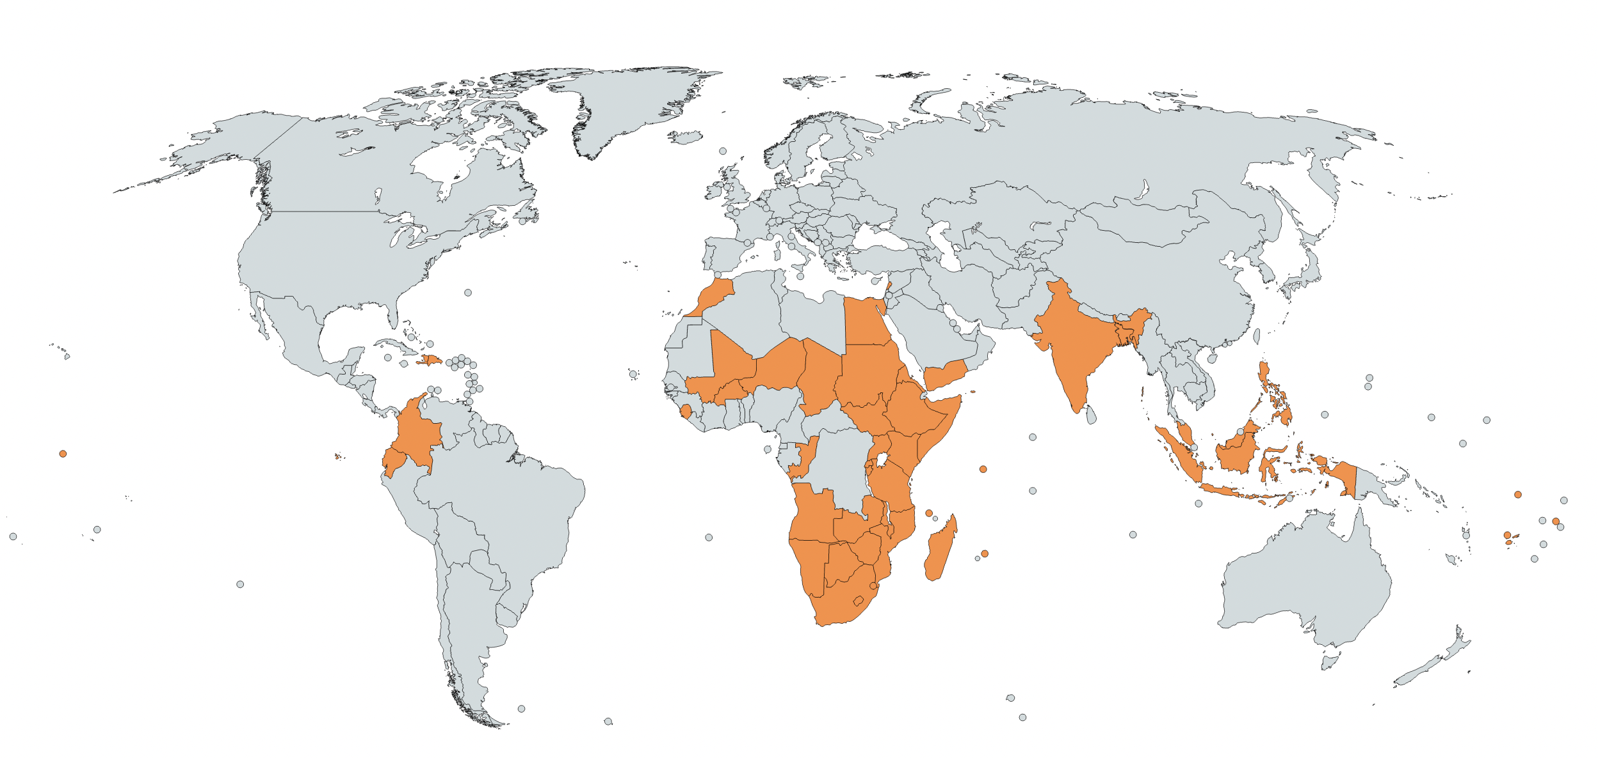
Nationally Determined Contributions UNFPA/QM Review
How do NDCs (1st wave of submission) include and describe thematic areas relevant to SRHR?
Content analysis for all references to: SRHR,
  Gender,
  Health,
  Population Dynamics,
  Human Rights and Participation,
  Vulnerable Groups
50 countries including 6 from Arab States (Egypt, Lebanon, Morocco, Somalia, Sudan, Yemen)
# of NDC references to …
6/50 - direct SRHR references (MH/ FP/ GBV/ HIV)
36/50 - gender
All 50 - health
25/50 - population dynamics as challenge
12/ 50 - human rights
40/50 - participation
38/50 -specific vulnerable groups (16/38 women)

Slide 15
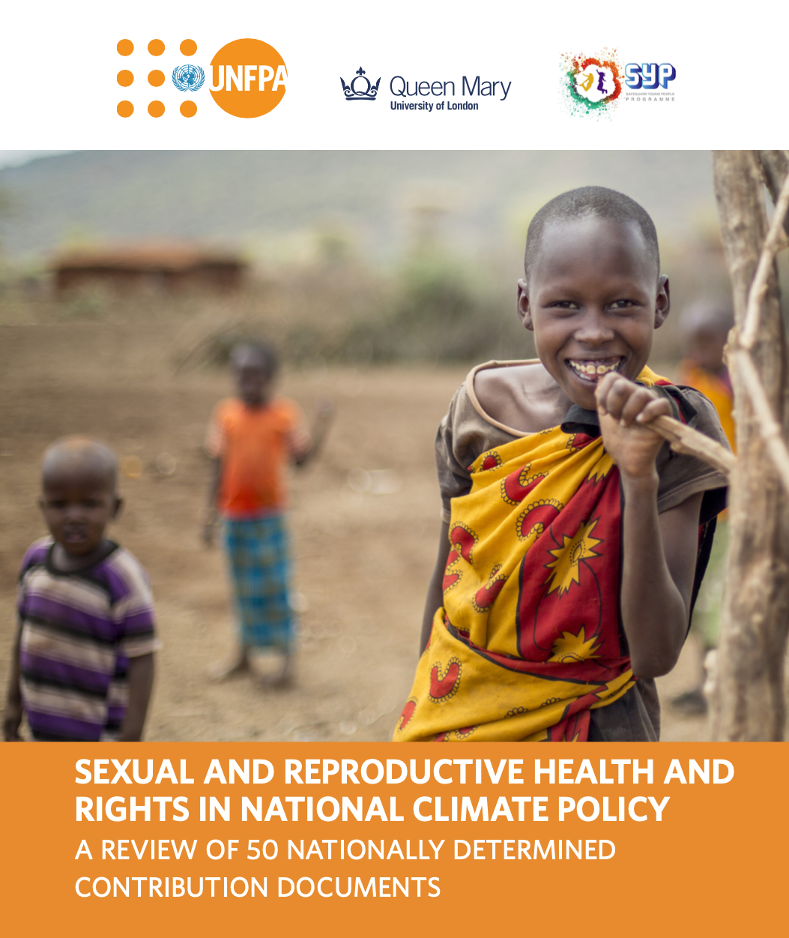
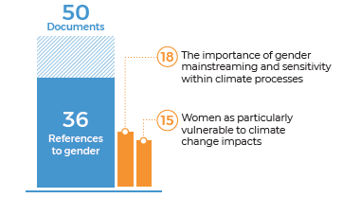
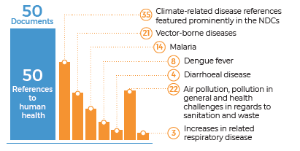
NDC UNFPA/Queen Mary University Review
Dr Heather McMullen, Queen Mary University of London

Slide 16
3. NDC Findings
Competition over resources and the potential for food and water scarcity to contribute to conflict
Yemen:
  "Climate change and expanding ecological scarcities’ may trigger ‘further social tensions and resources conflicts”
Somalia:
“Watering points have an inherent potential to act as conflict triggers”
Vulnerability of Health Sector
Morocco:
  "Vulnerability to climate change of the health sector is explained by the presence of endemic illnesses such as malaria, schistosomiasis, typhoid and cholera, likely to be made worse by climate change”
Notes:
Yemen comments that ‘climate change and expanding ecological scarcities’ may trigger ‘further social tensions and resources conflicts’ while Somalia describes how ‘watering points have an inherent potential to act as conflict triggers...particularly during times of drought’ (Yemen iNDC, 2015: p3; Somalia iNDC, 2015: p19). Sudan describes competition over resources and conflicts as a key area of vulnerability (Sudan iNDC, 2017: p11).

Slide 17
Key Findings Summary
Six out of the 50 NDCs included references to aspects of SRHR but there is scope for greater and more meaningful inclusion of the full range of SRHR.
Gender-based violence (GBV) represents a key intersection of SRHR and climate change that should be addressed in climate change adaptation policy.
The inclusion of SRHR and population dynamics in climate policy must be human rights -based and reflect the ICPD Programme of Action.
Realization of SRHR helps build resilience and adaptive capacity for climate change while reducing inequality and enabling justice.

Slide 18
Integrating SRHR into CC Policies Key Actions and Next Steps

Slide 19
Key actions - Healthy and Empowered population
Ensure the inclusion and representation of women, vulnerable groups and those with diverse sexual orientations, gender identities in climate change policy and planning.
Ensure the integration of SRHR into national climate plans and its implementation year round in the most vulnerable communities
Specifically recognise SRHR as an area of climate change impact and as crucial for building resilience and adaptive capacity as it intersects aspects of gender equality, human rights, health, population dynamics and enhanced vulnerability to climate change.
Assure expanded opportunities for young people, who are stepping up to the advocacy and innovation challenge of climate change.

Slide 20
Key actions to support SRHR in HSS & other systems
Mainstream climate resilience into health sector policies and plans (link to SDG 3 & 5).
Ensure integration, by governments, of SRHR, gender in/NAPs in their post-2020 climate adaptation actions, in line with the principles and approaches of the ICPD Programme of Action.
Reflect the differentiated and intersecting health impacts of climate change on gender, and groups with multiple and intersecting vulnerabilities (link to SDG 3).
Ensure minimal environmental impact of health commodities including SRHR.

Slide 21
Key actions to support Risk Reduction
Develop and strengthen assistance/social protection programmes for women and vulnerable groups who have lost their livelihoods to climate-related disasters (link to SDG 1, 5).
Ensure that national climate action, particularly adaptation action, is gender-sensitive
Increase financial support to developing countries for anticipatory action on climate-related disasters incorporating SRHR (link to SDG 17).
Build the capacity of local governments to ensure the maximum protection of the most vulnerable groups before disaster, during and post disaster

Slide 22
Key actions to support population data and VA
Ensure that climate-related vulnerability assessments and actions take into account SRHR/GBV risks and protective measures and are informed by disaggregated population data.
Build awareness, knowledge, and capacity on the links between climate-related hazards and SRHR, gender-based violence, child marriage and other harmful practices within the next five years (link to SDG 5).
Ensure that climate resilience is rights-focused, gender-sensitive and people-centered

Slide 23
Key UNFPA - Resources
UNFPA site on Climate Change (link)
UNFPA Value Proposition on Climate change, gender and SRHR, March 2021 (link)
UNFPA and Queen Mary University. Sexual and reproductive health and rights in national climate policy - A review of 50 Nationally Determined Contribution Documents. July 2021
SRHR, Gender and Climate Change Resilience symposium report, November 2019 (link)

Slide 24
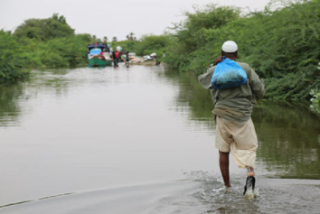

For more information or contributions please reach out to
Angela Baschieri baschieri@unfpa.org
Chiagozie Udeh
udeh@unfpa.org
Thank
you

