Slide 1
The Use of Radio Programmes to Promote Adoption of Climate-Smart Farming Technologies In Kenya. The Case of Migori County
AFRICA SOCIAL AND BEHAVIOUR CHANGE COMMUNICATION (SBCC) PRESENTATION
Enock Mac’Ouma

Slide 2
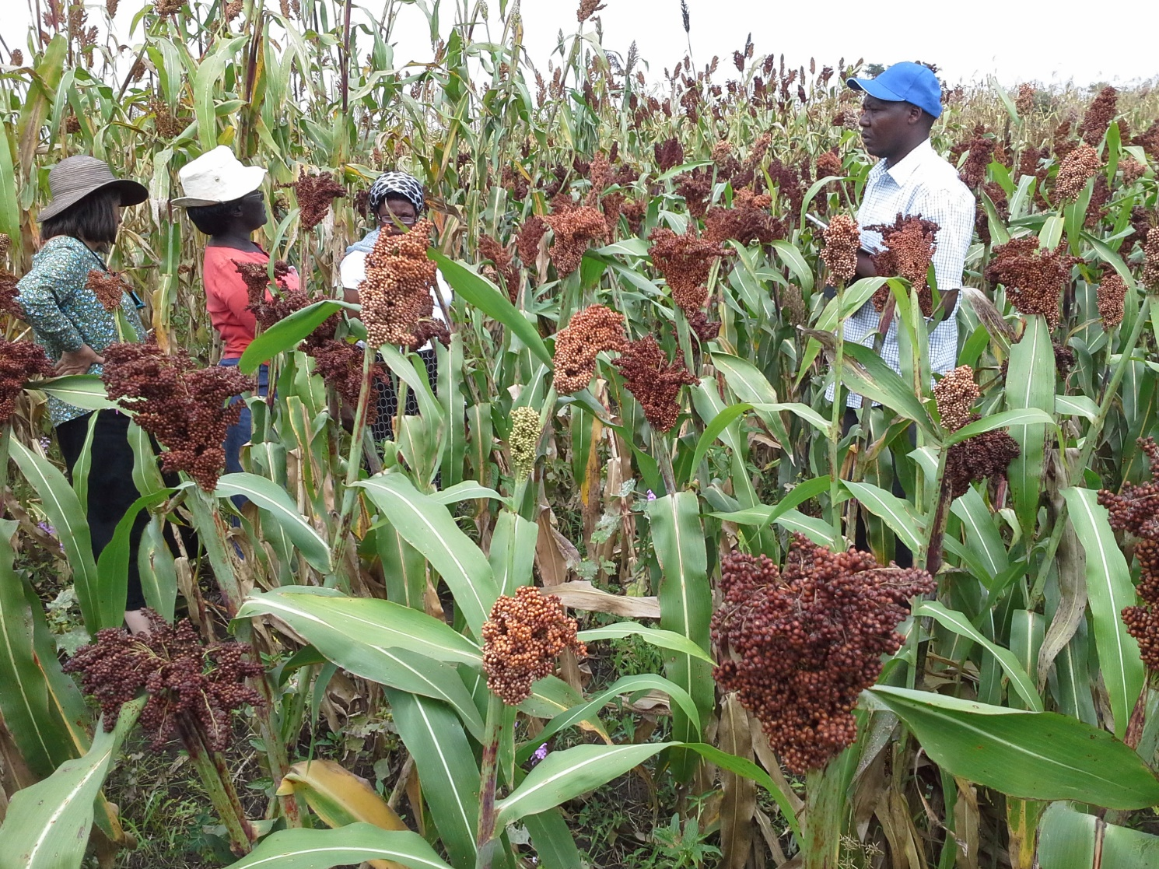
Presentation Outline
Background on the case study site
Highlights of the Background Chapter
Key challenges
Highlights of the literature review chapter
The aim, goal and objectives
Theoretical underpinning
Methodology
Partner organizations
What the research aims to achieve

Slide 3
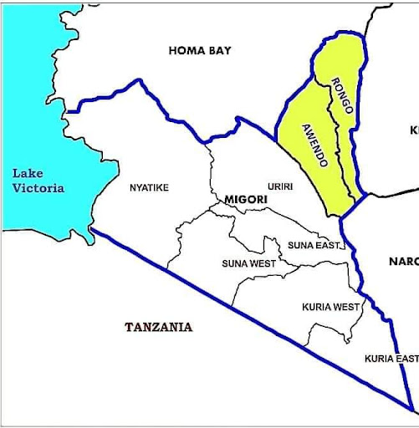
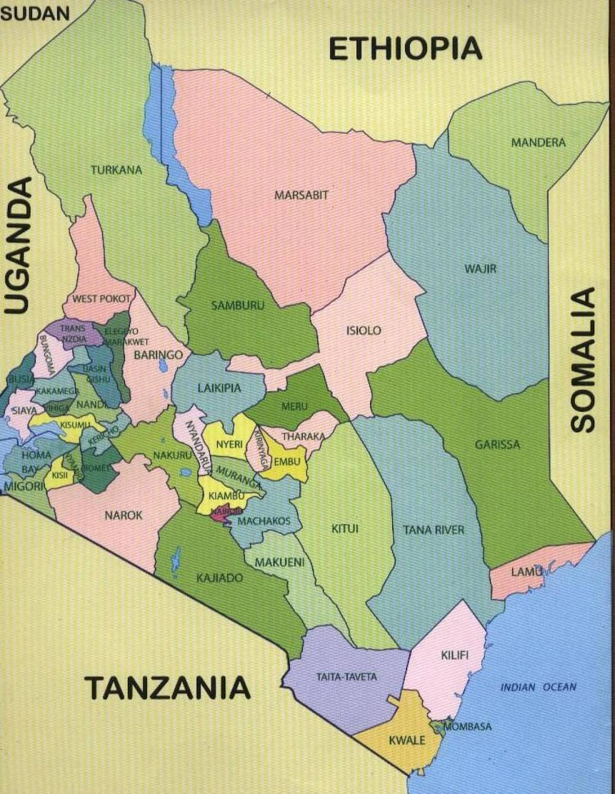
Migori County
Source: Migori County assembly website

Slide 4
The Background Chapter
Migori County is situated in the former Nyanza Province in Western Kenya and became an administrative unit through the Constitution of Kenya (2010)
The County is further divided into smaller administrative units known as sub-counties namely. The sub-counties are: Awendo, Kuria East, Kuria West, Rongo, Suna East, Suna-West, Nyatike and Uriri
The County is multi-cultural with several Indigenous languages spoken (Luo, Suba, Kuria, Luhya, Kiswahili) (Sangili et.al, 2017)
It has a population of 1,160,000 which is expected to grow to 1,680,450 by the year 2030 (Kenya National Bureau of Statistics, 2019)
It’s creation is entrenched in the County Government Act (of Kenya) 2012
Crop production, fishing and cattle rearing are the main economic activities
Farmers are not able to produce enough food to feed a growing population

Slide 5
The Key Challenges In Migori
Climate change
Hunger & malnutrition
Poverty
Unreliable rainfall patterns, severe drought and flash floods
49 % of Migori population are vulnerable to hunger while child malnutrition is at 69% (Onyango & Obade, 2017)
41% of Migori population are poor (Onyango & Obade, 2017)

Slide 6
The Literature Review Chapter
Begins with the history of agricultural extension which according to Jones & Garforth (1997), can be traced to 1850 when Cambridge and Oxford universities began discussions on how they could serve the knowledge needs of farmers around them
Traces the history and advancement of the concept of Communication for Development (C4D) which has lately been integrated into development practice in the global South by the Food and Agricultural Organization (FAO, 2021) and several other development agencies
Explains the effect of climate change on agricultural production and research efforts to innovate more sustainable and resilient farming practices generally known as “climate-smart farming technologies”
Discusses the current trends of using C4D in agricultural extension work through radio platforms

Slide 7
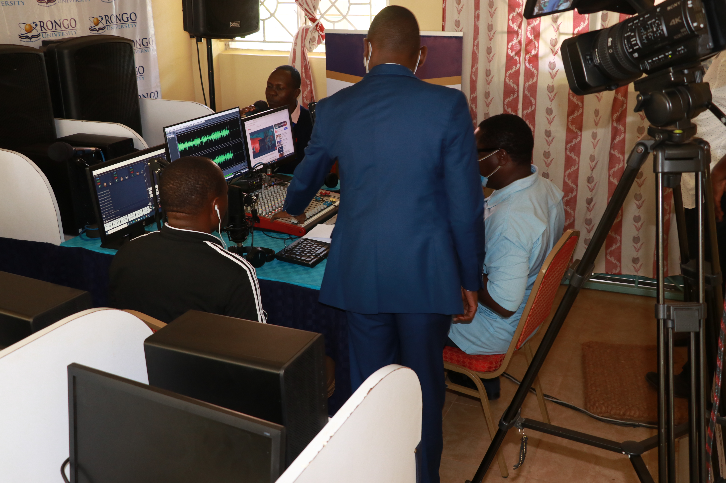
The Aim And Goal
The aim is to investigate ways by which information about climate-smart farming is currently being communicated to smallholder farmers in Migori, Kenya
The goal is to understand how community radio programmes can be used to improve communication with and between farmers

Slide 8
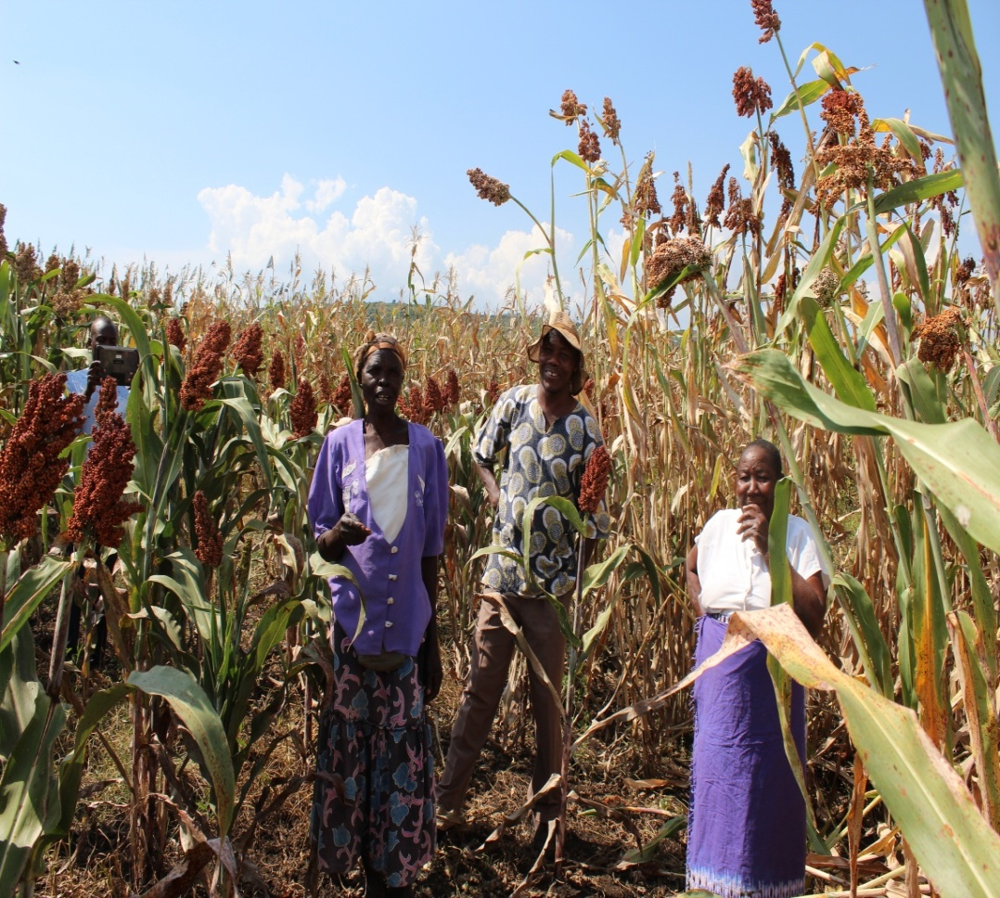
Research Objectives
Objective 1: investigate how information about climate-smart farming is currently transferred to smallholder farmers
Objective 2: investigate how communication about climate-smart farming between farmers and agricultural experts can be improved through radio programmes
Objective 3: explore how community radios in Migori County can improve communication about climate-smart farming

Slide 9
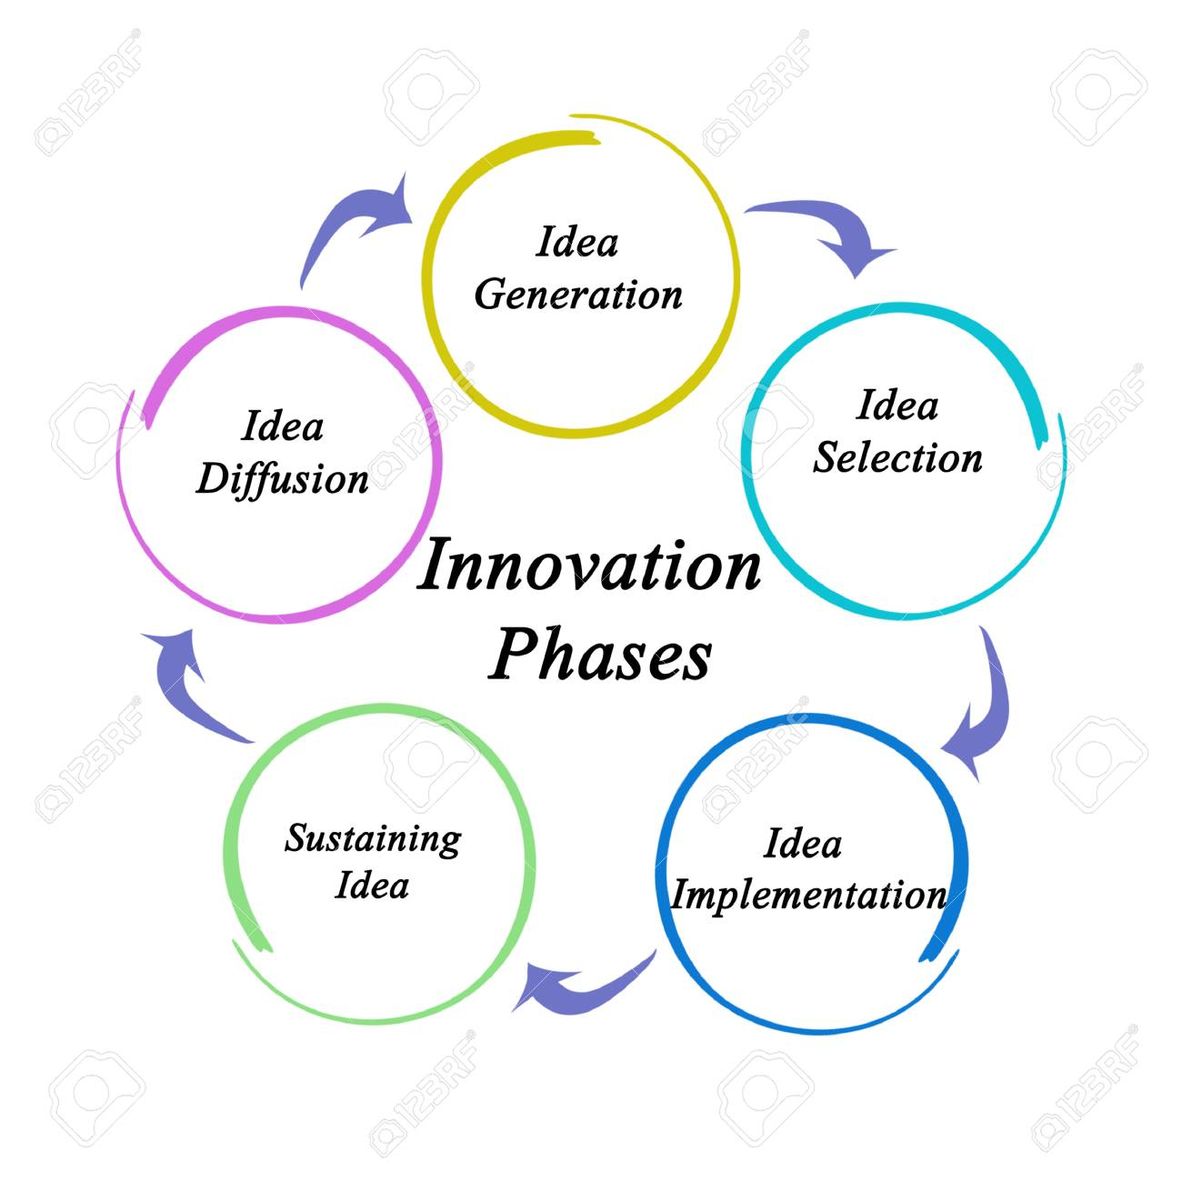
Theoretical Underpinning
The research is grounded in the diffusion of innovation theory developed by E.M. Rogers in 1962.
Diffusion is a social process that occurs, for
example, when food growers are learning innovative ways of farming (Dearing & Cox, 2018).

Slide 10
Methodology
I will apply a qualitative research approach for two reasons.
Firstly, this is a case study, where I will not be concerned with numerical data, but with a deep understanding of how information about climate-smart farming technologies is currently being communicated to farmers and how this process (extension) can be made more efficient through the use of community radios in Migori, Kenya.
Secondly, I will be dealing with aspects of reality about communication of knowledge about climate-smart farming, which cannot be quantified but described in factual terms (Faria & Queiros, 2017).

Slide 11
Project Partners
I will work with the following local organizations:
Radio Rameny – 88.3 FM, Radio Milambo – 103.8 FM, Radio Onagi – 98.1 FM, Radio Togotane – 88.3 FM and Anyuola Radio – 107.3 FM
Two women groups involved in subsistence farming for at least three years
Two youth groups involved in subsistence farming for at least three years
The Department of Agriculture, Fisheries and Livestock Development of the County Government of Migori
One Acre Fund – an agro-based NGO working with smallholder farmers in Migori County

Slide 12
What the research aims to achieve
Redefine the role of community radio in Migori, Kenya
Make agricultural research and expert opinions more accessible to smallholder farmers through radio platforms
Make the process of learning about climate-smart farming more engaging and participatory
Amplify Indigenous voices in scientific debates and conversations about climate-smart farming

Slide 13
THANK YOU
Please do you have any questions?

